Slide 1


Bartolomé Mestre Fons
July 2024

Slide 2

Outline
Executive Summary
Introduction
Methodology
Results
Conclusion
Appendix
2
Notes:
47

Slide 3
Executive Summary
Summary of methodologies
Data collection
Data wrangling
EDA with data visualization
EDA with SQL
Building an interactive map with Folium
Building a Dashboard with Plotly Dash
Predictive analysis (Classification)
Summary of all results
Exploratory data analysis results
Interactive analytics demo in screenshots
Predictive analysis results
3

Slide 4
Introduction
Project background and context
The era of commercial space has arrived, and there are several companies that are making
space travel affordable for everyone. One of them is SpaceX where its rocket launch is relatively inexpensive.
SpaceX advertises Falcon 9 rocket launches have a cost of 62 million dollars;
other providers cost upward of 165 million dollars each, much of the savings is because SpaceX
can reuse the first stage.
Therefore, we will predict if the Falcon 9 first stage will land successfully. If we can determine
if the first stage will land, we can determine the cost of a launch. This information can be used if
an alternate company wants to bid against SpaceX for a rocket launch.
• Problems you want to find answers
- Correlations between each rocket variables and successful landing rate
- Conditions to get the best results and ensure the best successful landing rate
4

Slide 5

Section 1
4

Slide 6
Methodology
Executive Summary
Data collection methodology:
SpaceX API & Web Scraping Falcon 9 and Falcon Heavy Launches Records from Wikipedia
Perform data wrangling
Convert outcomes into Training Labels with the booster successfully/unsuccessful landed
Perform exploratory data analysis (EDA) using visualization and SQL
Perform interactive visual analytics using Folium and Plotly Dash
Perform predictive analysis using classification models
Find best Hyperparameter for SVM, Classification Trees and Logistic Regression
4
Notes:
47

Slide 7
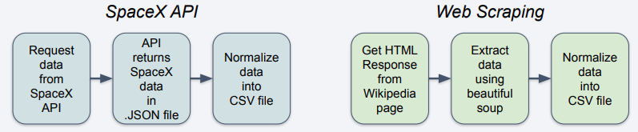
Data Collection
The data collection process is a composite of API requests from the SpaceX API and web scraping data from a
table in the Wikipedia page of SpaceX, Falcon 9 and Falcon Heavy Launches Records.
SpaceX API Data Columns: FlightNumber, Date, BoosterVersion, PayloadMass, Orbit, LaunchSite, Outcome,
Flights, GridFins, Reused, Legs, LandingPad, Block, ReusedCount, Serial, Longitude, Latitude
Wikipedia Web Scrape Data Columns: Flight No., Launch site, Payload, PayloadMass, Orbit, Customer,
Launch outcome, Version Booster, Booster landing, Date, Time
6

Slide 8
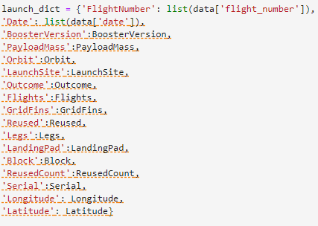
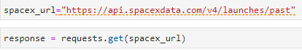
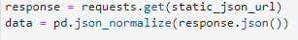
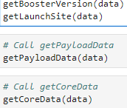
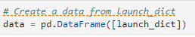
Data Collection – SpaceX API
1. Requesting rocket launch data from SpaceX API
2.Converting response to a JSON file
3. Cleaning data
4. Defining a dictionary to convert it to a dataframe
5. We only keep the Falcon 9 records
6. We export the saved records to a cv file
7

Slide 9
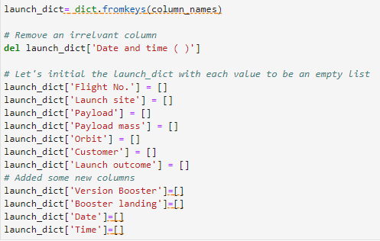
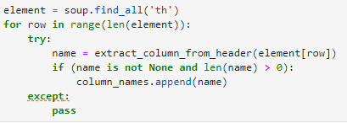
Data Collection: Scraping
1. Getting response from HTML
2. Generating the Soup object
3. We look for all the table elements
4. We extract all columns names on by one
5. We create an empty dictionary with keys
6. We convert the previously defined dictionary to a
Dataframe and save it as a cv file
8

Slide 10
Data Wrangling
We catalog all the possible failure or successful outputs of the mission:
True Ocean: the mission result has successfully landed in a specific area of the ocean
False Ocean: the mission result has not successfully landed in a specific area of the ocean
True RTLS: the mission result successfully landed on the ground pad
False RTLS: the mission result has not successfully landed on the ground pad
True ASDS: the mission result has successfully landed on the drone ship
False ASDS: the mission result has not landed on the drone ship
These categorical outputs can be transformed into numerical values:
1 = successful / 0 = failure
9

Slide 11
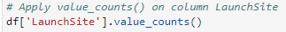
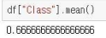
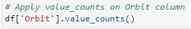
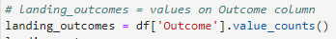
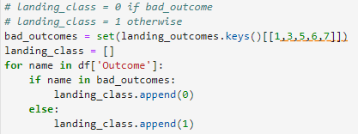
Data Wrangling
1. We calculate the number of launches at each launch site
2. We calculate the number and occurrence of each orbit
3. We calculate the number and occurrence of mission
outcome per orbit type
4. We transform the mission outcome to numerical values
5. We calculate the successful/failure rate
6. We transform our records to a cv file
10

Slide 12
EDA with Data Visualization
We will plot the following data in scatter plots:
Flight Number vs. Launch Site
Payload vs. Launch Site
Flight Number vs. Orbit Type
Payload vs. Orbit Type.
Also, bar charts will be deployed to visualize the relation between the following variables:
Orbit Type vs. Success Rate
Finally, Line Charts will be used to study the relation between the following variables.
Year vs. Success Rate
A scatter plot shows how much one variable is affected by another. The relationship between two variables is called a correlation.
A Bar chart makes it easy to compare datasets between multiple groups at a glance. It is also useful to visualize how one categorical variable may affect numerical variables.
Line Charts are useful to visualize trends on the correlation
Between two numerical variables.
11

Slide 13
EDA with SQL
We will execute SQL queries to complete the following tasks:
Displaying the names of the unique launch sites in the space mission
Displaying 5 records where launch sites begin with the string 'CCA'
Displaying the total payload mass carried by boosters launched by NASA (CRS)
Displaying average payload mass carried by booster version F9 v1.1
Listing the date when the first successful landing outcome in ground pad was achieved
Listing the names of the boosters which have success in drone ship and have payload mass greater than 4000 but less than 6000
Listing the total number of successful and failure mission outcomes
Listing the names of the booster_versions which have carried the maximum payload mass
Listing the failed landing_outcomes in drone ship, their booster versions, and launch site names for in year 2015
Ranking the count of landing outcomes (such as Failure (drone ship) or Success (ground pad)) between the date 2010-06-04 and 2017-03-20, in descending order
12

Slide 14
Build an Interactive Map with Folium
The following objects are added to our Folium map:
Markers that show all launch sites on a map
Markers which color shows the success/failure of the launch site
Lines that show the distances between a launch site to other objects in the map
By adding these objects, one can answer the following questions:
Are launch sites in close proximity to railways? Yes
Are launch sites in close proximity to highways? Yes
Are launch sites in close proximity to coastline? Yes
Do launch sites keep certain distance away from cities? Yes
13

Slide 15
Build a Dashboard with Plotly Dash
We write a Dashboard code which will deploy a Pie chart and a Scatter plot.
Pie chart
This chart indicates the successful landing distribution across all launch
sites
Scatter chart
In here, we will show the relationship between Outcomes and Payload mass(Kg) by different boosters
Our code will be design to have 2 inputs: All sites/individual site & Payload mass on a slider between 0 and 10000 kg
The aim of this last chart is to visualize how success may be related to the the launch point, payload mass, and booster version categories
14

Slide 16
Predictive Analysis (Classification)
Perform exploratory Data Analysis and determine Training Labels
Create a column for the class
Standardize the data
Split into training data and test
data
Find best Hyperparameter for SVM, Classification Trees and Logistic Regression
Find the method performs best using test data
Thus, we will build a model, we will evaluate it, improve it if necessary and select
the most successful classification model.
15

Slide 17
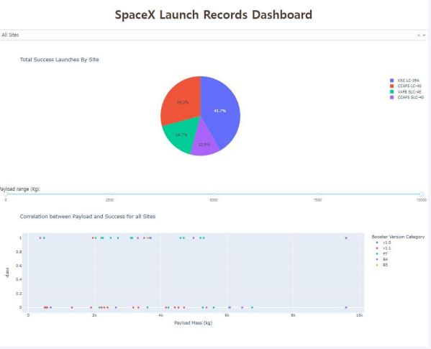
Results
Here, we plot the output of the Dashboard codes. At the top right of the slide, the Total Success Launches by Site, and at the bottom left, the Correlation between Payload Mass and Success for all Sites
From a comparison between the accuracy value returned by the 4 classification methods used, one can find that all of them provide an accuracy value of 83% for test data.
17
Notes:
<number>

Slide 18

Section 2

Slide 19
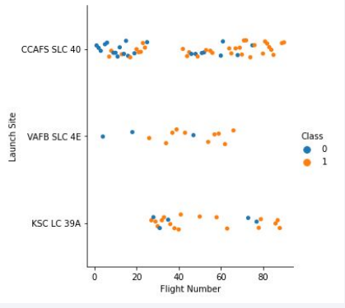
Flight Number vs. Launch Site
Class 0 (blue) represent unsuccessful launches, while class 1 (orange) represent successful launches.
One can observe that the higher the flight number, the higher the number of successful launches.
Specially, the success rate increases dramatically since the 20th launch.
17

Slide 20
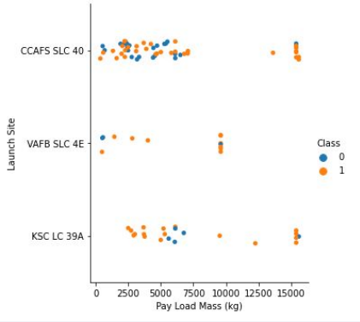
Payload vs. Launch Site
Class 0 (blue) represents unsuccessful launch, and Class 1 (orange) represents successful launches.
It is observed a weak trend: that the higher the payload mass, the higher chance of success on the launch.
However, one needs to take in consideration more variables and factors in order discuss this weak trend observed.
19

Slide 21
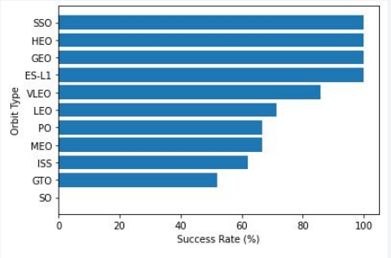
Success Rate vs. Orbit Type
The SSO, HEO, GEO and ES-L1 orbit types possess the higher success rate (100%).
Meanwhile, from the VLEO to the GTO orbit type we observe a downward trend on the success rate, reaching the SO orbit type where no success launch took place (0%).
20

Slide 22
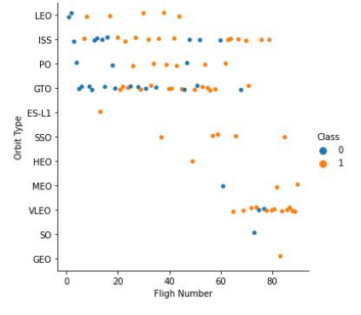
Flight Number vs. Orbit Type
Class 0 (blue) represents
unsuccessful launch, and Class 1
(orange) represents successful launch.
The first launches were intended to orbit in the
LEO orbit type. As more flights take place,
the success rate in this orbit type increases.
Meanwhile, the GTO orbit type returns the higher
number of failed launches in comparison with the
rest.
From all the entries of the chart, the SSO has a
100% success rate, being the most successful orbit
type.
Note that SpaceX intended its launches ot reach
MEO, VLEO and SSO orbit types towards the end.
21

Slide 23
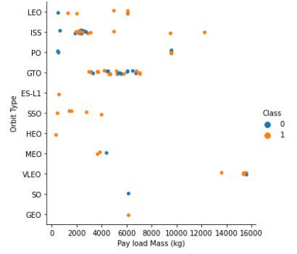
Payload vs. Orbit Type
Class 0 (blue) represents
unsuccessful launch, and Class 1
(orange) represents successful launch.
The LEO and ISS seem to work well with launches with High Payload Masses.
However, the GTO orbit type returns failure and successful landings for a Payload Mass range from 3000 to 7000 Kg.
22

Slide 24
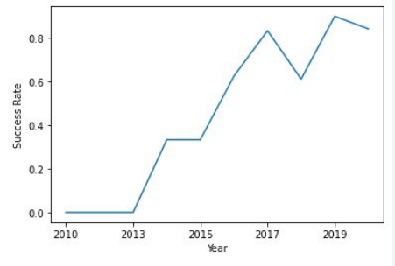
Launch Success Yearly Trend
Since 2013, the success rate increases until 2014.
Here, it stabilizes. Then it sharply grows until 2017
where it plummets reaching the 0.6 success rate in 2018. From then to 2020, the growth seems to be
not as steady as the first years of record.
23

Slide 25
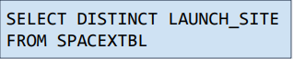
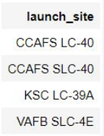
All Launch Site Names
We deploy our SQL skills to retrieve valuable information from the datasets provided:
SQL query
Output
The DISTINCT clause enables the user
to retrieve all the different entries in the
LAUNCH_SITE column from the SPACEXTBL
table.
24

Slide 26
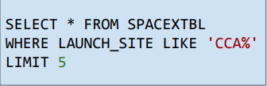
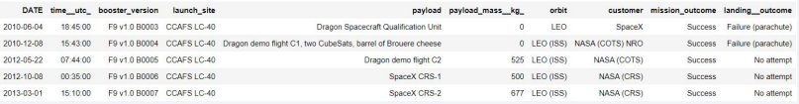
Launch Site Names Begin with 'CCA'
SQL query
Output
The DISTINCT clause enables the user
to retrieve all the LAUNCH_SITE entries which
start with CCA. LIMIT 5 limits the number of
retrieved rows to 5
25

Slide 27
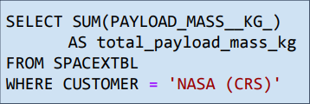
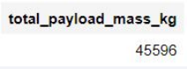
Total Payload Mass
SQL query
Output
The SUM clause enables the user
to retrieve the summation of all entries of the column PAYLOAD_MASS_KG_ and recall it
‘total_payload_mass_kg’ employing the AS statement. Finally, we will only perform this summation for the case the CUSTOMER is ‘NASA (CRS)’
26

Slide 28
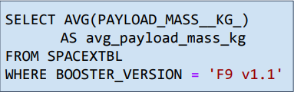
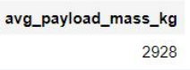
Average Payload Mass by F9 v1.1
SQL query
Output
The AVG clause enables the user
to retrieve the mean of all entries of the column PAYLOAD_MASS_KG_ and recall it
‘avg_payload_mass_kg’ employing the AS statement. Finally, we will only execute this query for the case the BOOSTER_VERSION is ‘F9 v1.1’
27

Slide 29
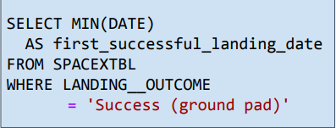
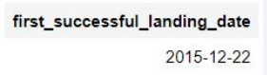
First Successful Ground Landing Date
SQL query
Output
The MIN clause enables the user
to retrieve the minimum of all entries of the column DATE and recall it
‘first_successful_landing_date’ employing the AS statement. Finally, we will only execute this query for the case the LANDING_OUTCOME is ‘Success (ground pad)’
28

Slide 30
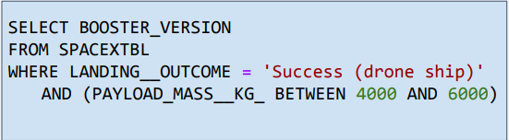
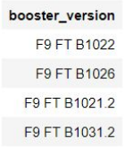
Successful Drone Ship Landing with Payload between 4000 and 6000
SQL query
Output
We retrieve only the BOOSTER_VERSION entries which satisfy the LANDING_OUTCOME to be ‘Success (drone ship)’ and the PAYLOAD_MASS__KG_ is between 4000 and 6000 Kg employing the AND clause to perform two conditionals at the same time.
29

Slide 31
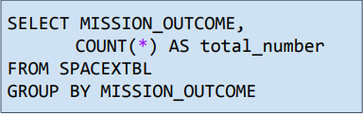
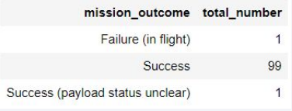
Total Number of Successful and Failure Mission Outcomes
SQL query
Output
We retrieve the MISSION_OUTCOME along the number of rows with the statement COUNT(*) from the SPACEXTBL. Here, we also group the output by the MISSION_OUTCOME employing the clause GROUP BY
30

Slide 32
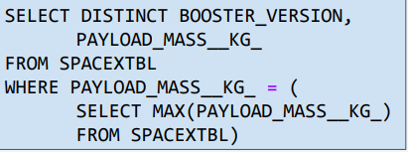
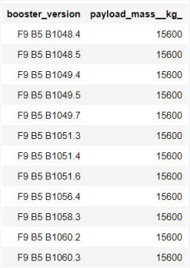
Boosters Carried Maximum Payload
SQL query Output
We retrieve all the unique entries of the column BOOSTER_VERSION along the PAYLOAD_MASS__KG_ entry from the table SPACEXTBL. We retrieve this values for the case the PAYLOAD_MASS__KG_ corresponds to its maximum employing a subquery.
31

Slide 33
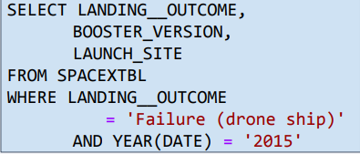
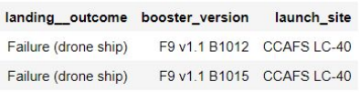
2015 Launch Records
SQL query Output
We retrieve the LANDING_OUTCOME along the BOOSTER_VERSION and the LAUNCH_SITE entries from the table SPACEXTBL. We retrieve this values for the case the LANDING_OUTCOME corresponds to ‘Failure (drone ship)’ and the year is ‘2015’. This last step is performed using the YEAR clause over the DATE column of the table, which returns the year of the launch.
32

Slide 34
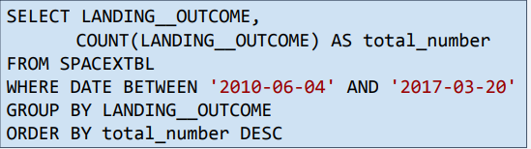
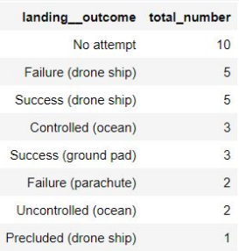
Rank Landing Outcomes Between 2010-06-04 and 2017-03-20
SQL query Output
We retrieve the LANDING_OUTCOME along the number of types of LANDING_OUTCOME with the clause COUNT, from the table SPACEXTBL. This last value is returned as ‘total_number’ using the AS clause. The data retrieved is conditioned to have a date between ‘2010-06-04’ and ‘2017-03-20’. Also, we group the output by the LANDING_OUTCOME using GROUP BY. Finally, the output is sorted by the ORDER BY clause, in decreasing order.
33

Slide 35

Section 3

Slide 36
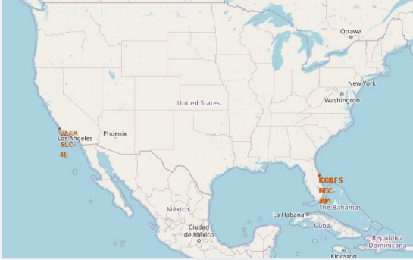
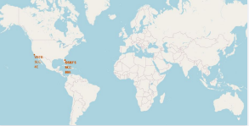
Where did everything take place?
We display a map of the United States
at the left and a global map on the top
of this text. One can see from these
maps that all launches took place in the
coastline of the United States, whether
in the west or in the east coastline.
34

Slide 37
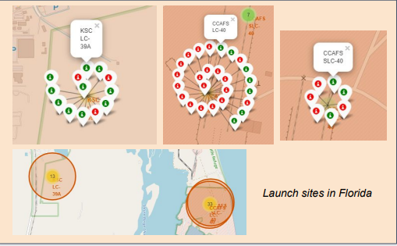
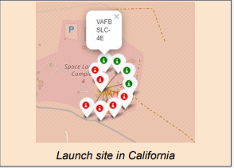
Too boring… let’s add some colors
In the left picture we deploy a screenshot of the all the launches which took place in Florida and in the
left picture, all the launches which took place in California. All launches are labeled depending on the
mission outcome: red if the mission was unsuccessful and green if it was a success.
36

Slide 38
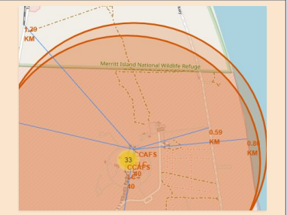
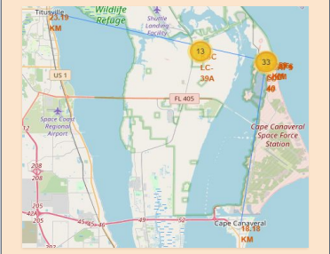
What is nearby? Let’s find ‘em!
An exploratory analysis nearby reveals a possible failure launch would not pose a threat to any town or city located nearby (the closest city is Titusville, at a distance of 23.19 Km). Also, the launch site is strategically located so highways and railways are close and personnel and equipment can be easily transported.
37

Slide 39

Section 4

Slide 40
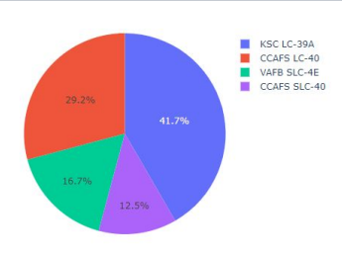
Total Success Rate by all the Launch Sites
KSLC-39A provides the highest success rate of all launch sites (41.7%).
CCAFS LC-40 possess the second highest success rate (29.2%).
Finally, VABF SLC-4E and CCAFS SLC-40 have the lowest success rate (16.7% and 12.5%, respectively).
Note that one reason which may explain the low success rate at the VAFB SLC-4E launch site is the location: located in the California coastline, it may pose an added difficulty.
38

Slide 41
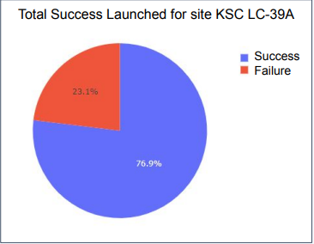
Launch Site which Highest Success Rate
KSC LC-39A possess the highest success rate ofnall the launch sites analyzed. It has a 76.9% rate of Success rate against a 23.1% rate of Failure.
40

Slide 42
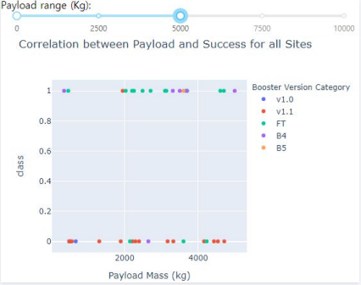
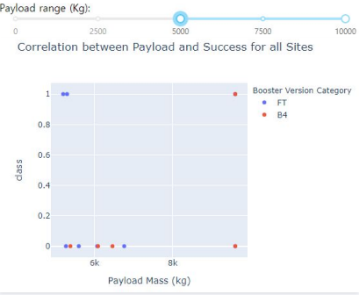
Payload vs. Launch Outcome scatter chart for all sites
The charts above support the trend of achieving a higher success rate as the payload mass decrease:
there are more successful launches (class 1) for light payloads (0-5000 Kg) than for heavy payloads
(5000-10000 Kg)
41

Slide 43

Section 5

Slide 44

Classification Accuracy
The chart at the left provides an insight on the accuracy
score returned by the 4 Classification Methods employed.
All of them return an accuracy score of 0.83. Therefore,
more data is needed determine which method performs
the better.
42

Slide 45

Confusion Matrix
First, note that since all models provided
the same accuracy score, all models will
possess the same Confusion Matrix.
The models predicted 12 successful
landings when the true label was
successful and 3 failed landings when
the true label was failure. But there
were also 3 predictions that said
successful landings when the true label
was failure.
All in all, we can clearly conclude that the
landing will be successful.
44

Slide 46
Conclusions
• As the number of flights increases, the success rate has grown, reaching 80%.
• Orbital types SSO, HEO, GEO, and ES-L1 have the highest success rate (100%).
• The launch site is strategically located so railways, highways and coastline are nearby but
cities are far away.
• KSLC-39A has the highest number of launch successes among all sites.
• Low payload mass launches possess a higher success rate than heavy payload launches.
• All models analyzed provide an accuracy score of 0.83. Therefore, we suggest
repeating this analysis employing more data to determine the optimal model.
45

Slide 47
Appendix
Here we provide the GitHub URL where the reader can execute the code by himself:
GitHub URL
46
Notes:
<number>

Slide 48


